Slide 1


Employee App Catalog
A comprehensive product management case study exploring how we designed an enterprise solution to combat Shadow IT, reduce repetitive access requests, and eliminate inefficient workarounds through strategic app discovery and governance.

Slide 2
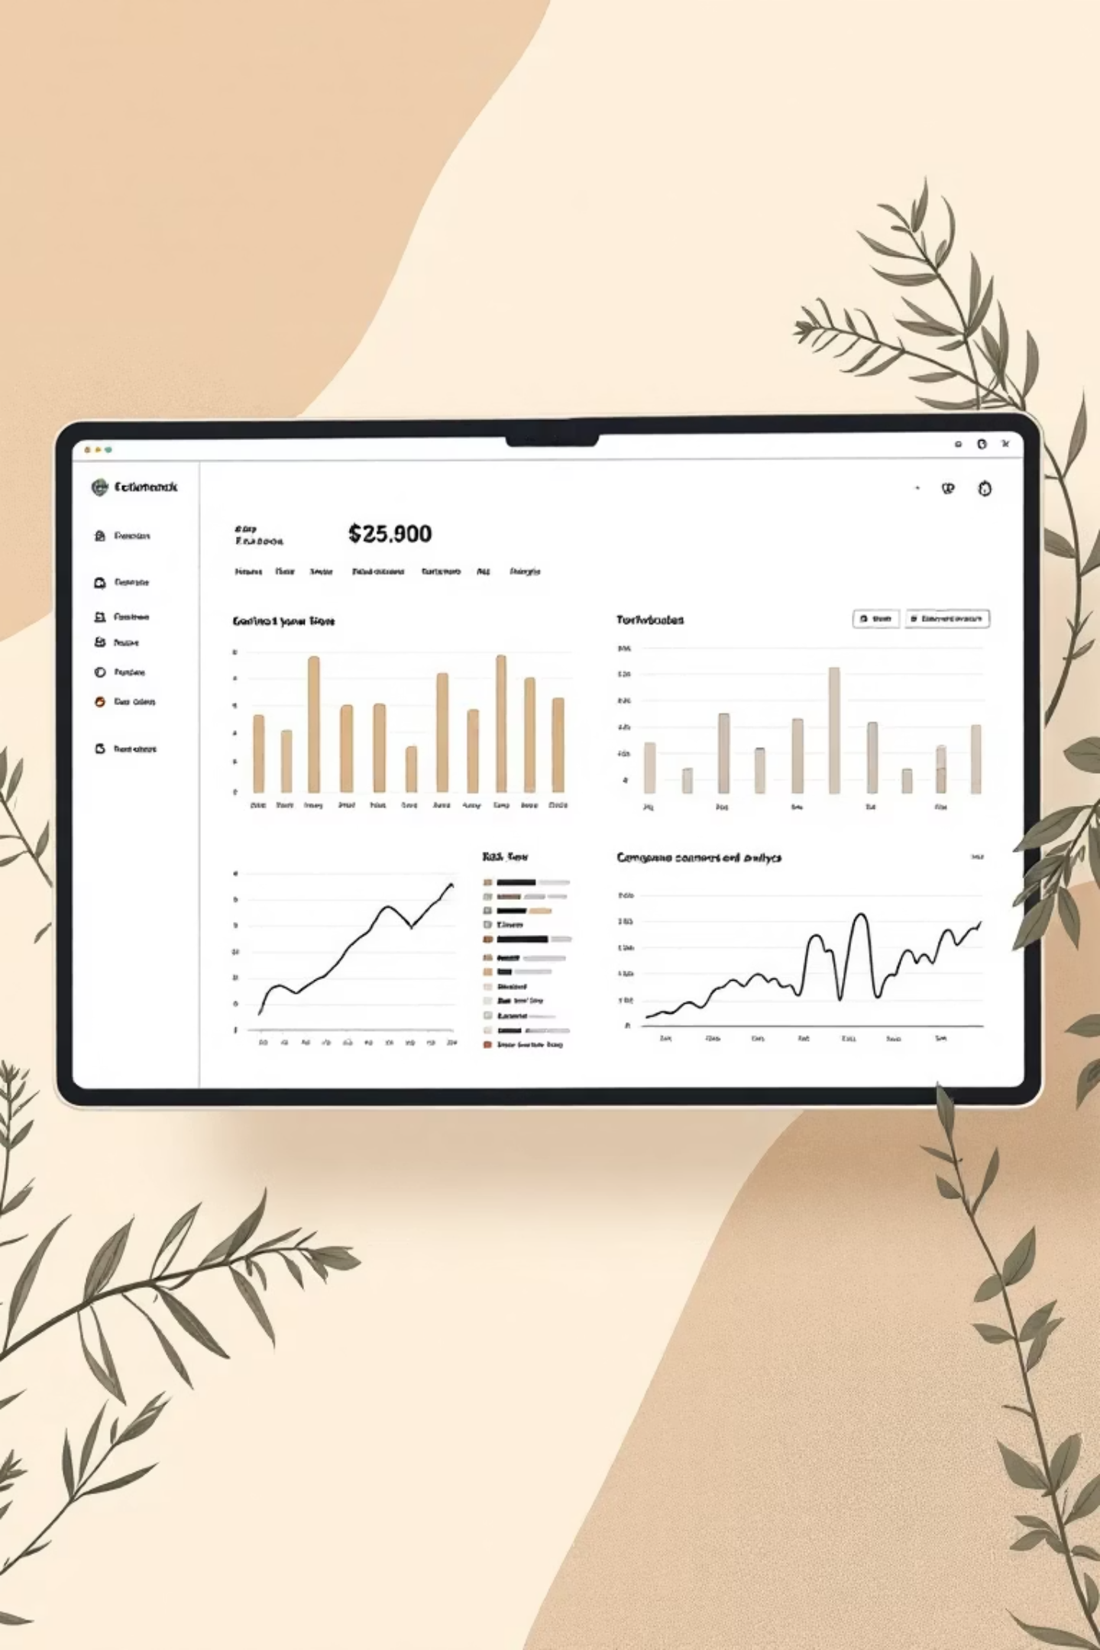
Competitive Research Insights
Our analysis of enterprise app stores, internal catalogs, consumer platforms, and IT service portals revealed four critical design principles that shaped our approach.
Explicit Access Status
Status indicators (Installed/Request Access/Pending) must be the most prominent visual element to reduce repeated IT inquiries and provide instant clarity.
Functional Categorization
Primary search and filtering organized by Business Function rather than department structure to solve actual business needs effectively.
Internal Social Proof
Replace external ratings with Internal Usage Metrics like "Used by 1,200 Colleagues" to build enterprise trust and confidence.
Consumer UX + Enterprise Governance
Deliver simple, visual, consumer-grade browsing while integrating strict approval workflows at the point of request.

Slide 3

Core Feature Specification
Our design balances intuitive discovery with enterprise governance, creating a seamless experience from browsing to approval.
App Discovery & Information
Access Management & Dashboard
Persistent, predictive search functionality
Dynamic status badges on every app card
Navigation by Function, Department, Trending
Personal "My Apps" launchpad section
Detailed app pages with IT owner contact
Pending requests tracker with visibility
Internal usage statistics for trust building
Off-ramp tool for app removal requests
Clear access requirements and approval chains
Role-based filtering and recommendations

Slide 4

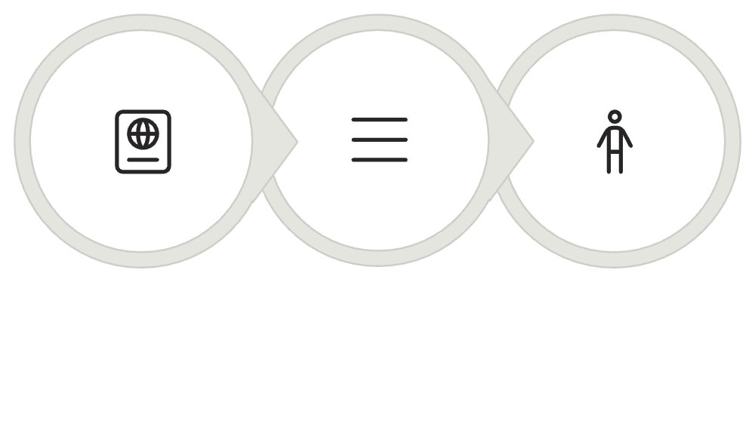



User Experience Scenarios
Three critical user journeys that validate our design approach and ensure comprehensive coverage of enterprise needs.
01
02
New Employee Onboarding
Existing User Tool Discovery
Role-based welcome with onboarding guide, department filters, and immediate access to pre-provisioned applications for their specific role and responsibilities.
Problem-solving journey using search bar, functional filters, internal usage comparison, and streamlined 3-step request flow with full approval visibility.
03
Department Transition
Role update workflow showing pending removal status for old apps while enabling bulk access requests for new role-based application requirements.
Justification
License Select
Approval Chain

Slide 5



Success Metrics Framework
Comprehensive measurement approach covering adoption rates, business impact, and discovery efficiency to track our solution's effectiveness.
User Adoption
Business Impact
App Discovery Efficiency
Catalog engagement rate measuring active employees who browse monthly, plus "My Apps" launch share tracking our success as the primary access point.
IT request deflection rate quantifying reduced support tickets, and Shadow IT reduction measuring success in routing discovery through approved channels.
Search-to-request conversion rate measuring the effectiveness of our search functionality and information display architecture.

Slide 6
Key Performance Indicators
Detailed metrics calculations that provide actionable insights into catalog performance and organizational impact.
Category
Metric
Calculation Method
User Adoption
Catalog Engagement Rate
Monthly active browsers ÷ Total employees × 100
User Adoption
"My Apps" Launch Share
Direct launches from catalog ÷ Total app launches
Business Impact
IT Request Deflection Rate
Catalog requests ÷ Total IT access tickets
Business Impact
Shadow IT Reduction
New catalog apps ÷ New unmanaged apps discovered
App Discovery
Search-to-Request Conversion
Approved requests from search ÷ Search detail views
These metrics enable continuous optimization of our app catalog solution, ensuring it delivers measurable value to both users and IT operations.

